Slide 1
ENSE 400
Mentor Scrum Report-Out
t2ee
Zuoxiu Xing
2019/11/22

Slide 2
Project deats
High-level what you are doing
  What problem(s) are you trying to solve?
    Self-Service Virtual Machine Deployment
  What gap are you filling?
    Providing virtual servers within University
  What innovation are you creating?
    Web interface and OpenStack

Slide 3
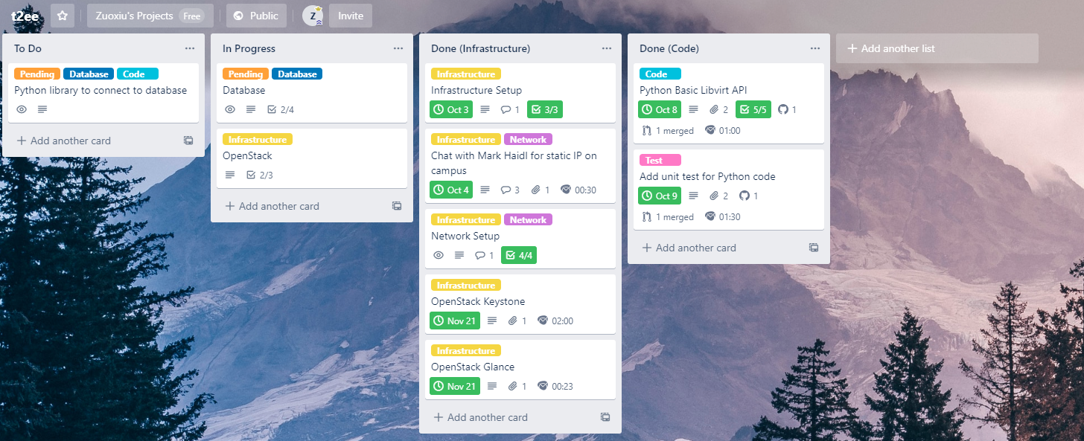
Project partial demo/documentation review

Slide 4
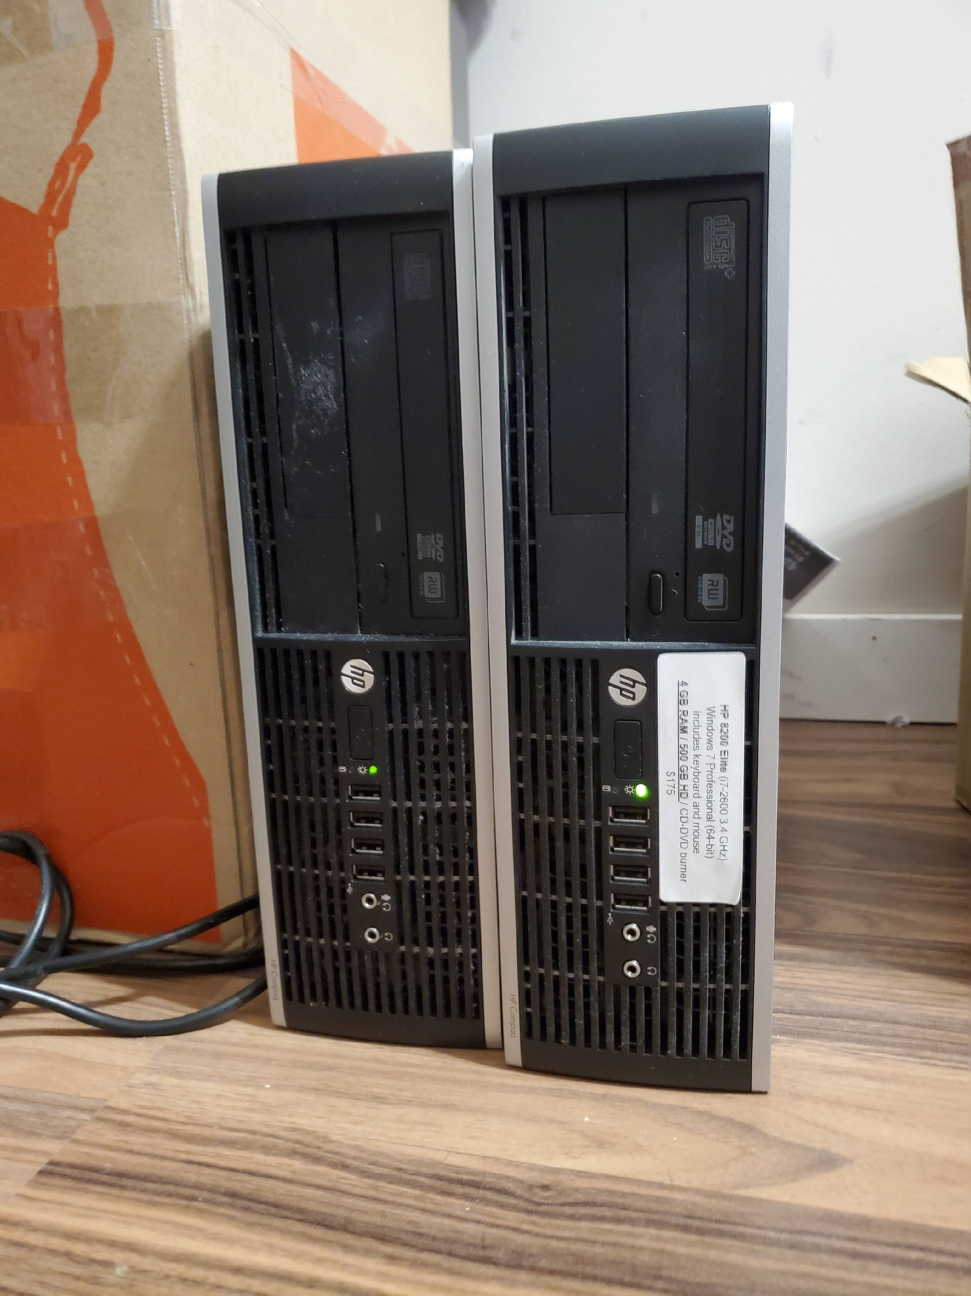
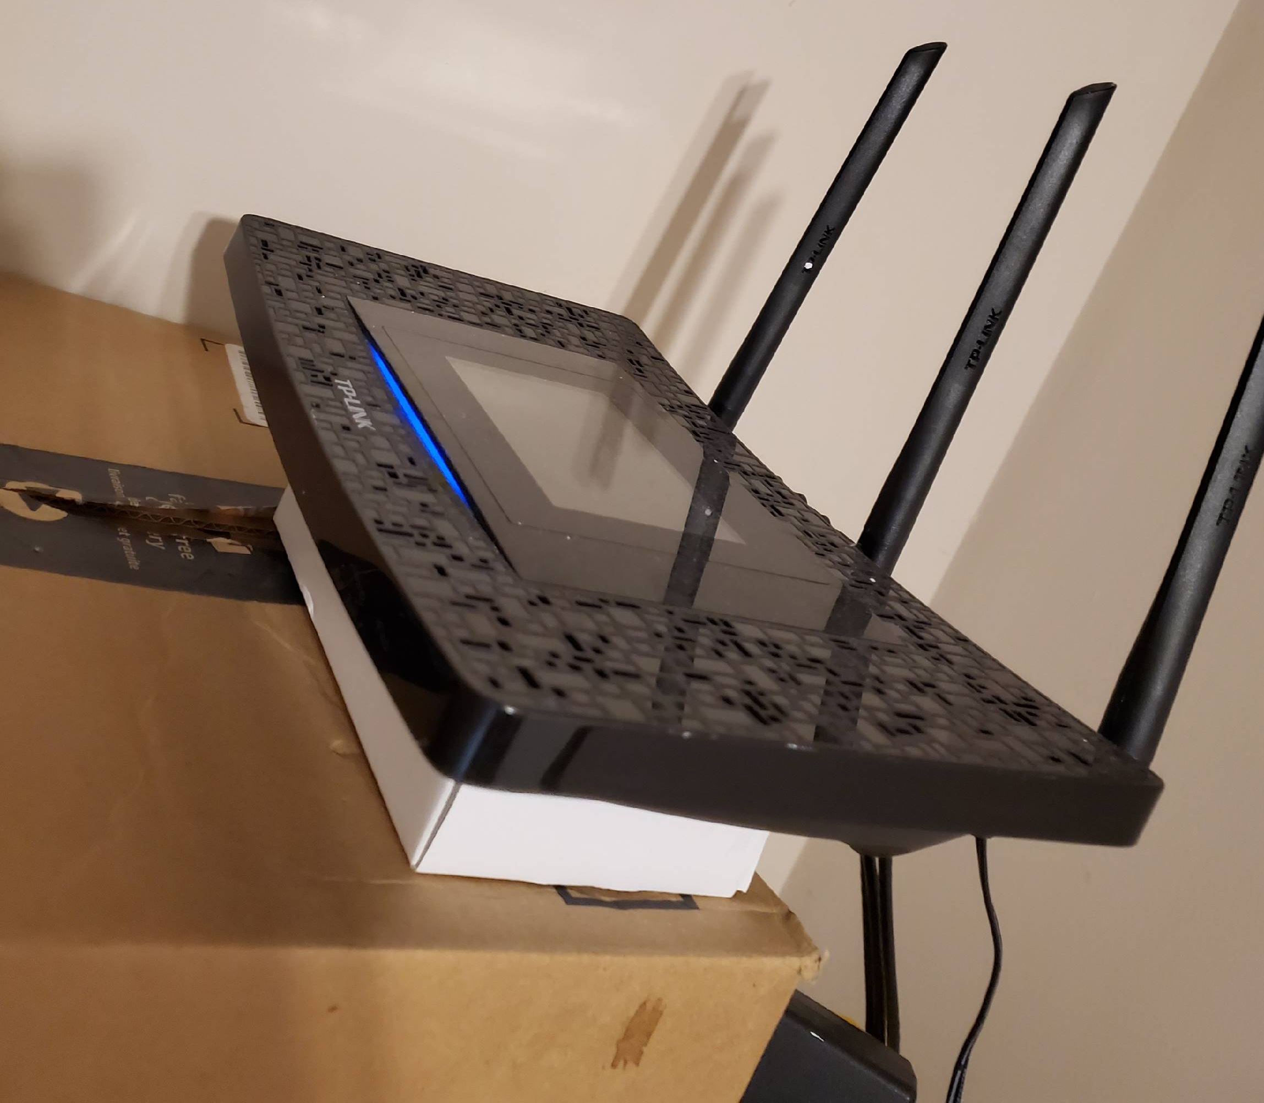
Project partial demo/documentation review

Slide 5
Group reflection
Do you feel you are on track?
  Yes
Do you feel there are barriers to your success (if any)?
  OpenStack

Slide 6
Mentor Q/A
It’s time to ask all mentors if they have any questions

